Slide 1
BUILDING RESILIENCY
Presented by:
Kate Carnes, Human Resources
Security and Employment Service Center
Kathleen.d.carnes@maine.gov
Telephone: 623-6730
Notes:
Script for Resiliency:
Slide 1 Hi, my name is Kate Carnes. Currently, I work in Human Resources in the Security and Employment Service Center, but before I came to this job, I spent many years providing staff training and development in State government. I am really happy to have this time with you to explore the topic of resiliency. These are trying times that test our ability to stay resilient.
What I am about to present are some parts of a resiliency workshop I have done for many years. There are lots of ways that people build, maintain and call upon their resiliency in challenging times. There is no recipe. No one way that works for everyone. Each of us is unique and each of us can find what is right and works for us. In fact, you are probably more resilient than you realize. I hope that what I am about to share with you will be useful to you during these challenging times.

Slide 2
What is Resiliency?
1.The process of adapting well in the face of adversity
2. The ability to recover from or adjust easily to change or misfortune
3. The ability of something to regain its shape after being bent, stretched or compressed
Notes:
Slide 2:
So, let’s start by describing resiliency. Resiliency is:
The process of adapting well in the face of adversity – human kind has been doing this since the beginning of time. All of us have the capacity to be resilient.
The ability to recover from or adjust easily to change or misfortune – change is a given and can challenge our usual routines; the way we are used to things being, and that tests our resiliency.
The ability of something to regain its shape after being bent, stretched or compressed
You can see many examples of this in nature. Think of the grass on the dunes at the beach, bending in the wind, yet coming back to an upright position and maintaining their footing. There are also many examples among human beings of resilience in the face of great challenges. Resiliency is all around us and in many forms.

Slide 3
10 Tips for Building Resilience
1. Stay flexible – expect challenges
2. Learn lessons - look for the positive lesson in the negative experience
3. Take action – solve the problem
4. Stay connected – nurture your relationships
5. Release tension – have outlets for expressing your emotions – keep a journal draw, paint, make music – find your creative outlet meditate talk with a friend or counselor go outside – get some fresh air, take a walk keep a list of what you are grateful for
Notes:
Slide 3:
Here are some tips for building and maintaining resilience:
1. Stay flexible – expect challenges. Life is full of them!
2. Learn lessons - look for the positive lesson in the negative experience. For most of us, these are times when we can and do learn a lot about our resolve and inner strength.
3. Take action – solve the problems within your circle of control.
4. Stay connected – nurture your relationships.
5. Release tension – have outlets for expressing your emotions – Here are just a few suggestions. Keep a journal – sometimes writing about our experience helps us make sense of our emotions and when re-read shows us how we got through a hard time. Draw, paint, make music. Find your creative outlet! Meditate – there is a lot of research showing the multiple benefits of meditation for improving health and relieving stress Talk with a friend or counselor – talking to a trusted friend or counselor can help us process our emotions and gain clarity about our thoughts
Go outside, get some fresh air. There are many benefits to being outside both for our physical well being and for our mental well being. Take a walk – walking is a good way to relieve tension and you don’t need any fancy equipment to do it.
Keep a list of what you are grateful for. When you think of the things you are grateful for it improves mental and physical health.
There are many ways to release tension. Find the one or ones that work best for you.

Slide 4
10 Tips for Building Resilience - Continued
6. Have a sense of purpose- do things that bring meaning to your life
7. Learn healthy habits - it will help you manage in stressful times – physical strength leads to emotional resiliency exercise eat a balanced diet take time to rest 8. Believe in yourself - recognize your personal strengths and accomplishments
9. Keep laughing - laughter relieves stress and helps you keep things in check.
10. Be optimistic - A positive, hopeful outlook will make you much more resilient.
Notes:
Slide 4:
Here are some more tips for building resilience:
6. Have a sense of purpose- do things that bring meaning to your life. There are many ways and opportunities to do this.
7. Learn healthy habits - it will help you manage in stressful times – physical strength leads to emotional resiliency. Exercise Eat a balanced diet - this can be a challenge in stressful times, but it is important for health and well being. Take time to rest – rest not only restores us physically, it is important in restoring us mentally
8. Believe in yourself - recognize your personal strengths and accomplishments
9. Keep laughing - laughter relieves stress and helps you keep things in check.
10. Be optimistic - A positive, hopeful outlook will make you much more resilient. As someone once said, “Pessimists might be right, but optimists live longer”

Slide 5
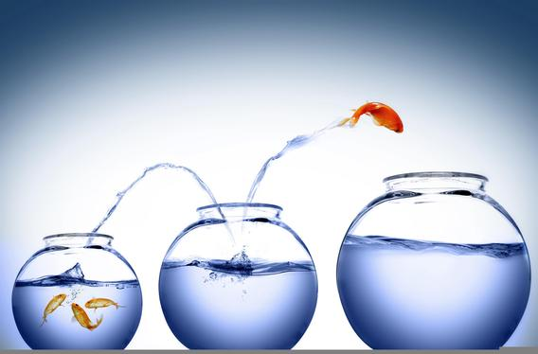
A Closer Look at a Few of the Tips:
Challenges
Think of a challenge you faced in your life:
What helped you get through that challenge?
What did you learn about yourself as a result?
Notes:
Slide 5: Let’s take a closer look at a few of these tips.
Challenges
We can think of challenges in wholly negative terms and sometimes they can appear to be just that. However, often with the passage of time we realize that as difficult or painful as the challenge was, we were more capable and stronger than we realized. You might have gained a renewed sense of connection to the people around you – perhaps a friendship was strengthened when someone reached out to support you. Challenges exist throughout our lives, they are a natural part of being alive.
Take a look at the challenges you have faced in your life. How you responded to them gives you insight into your strengths. When thinking about those challenges, ask yourself these questions: What helped you get through that challenge? Think about the actions you took and that others took that were helpful to you. What did you learn about yourself as a result and how can you use those lessons in the current challenge?

Slide 6
Take Action Situation Mastery
Can be controlled
Can’t be controlled
Take action: Situation Mastery
Don’t act: Giving up
Take action: Ceaseless striving
Don’t act: Letting go
Notes:
Slide 6:
Take action. Situation mastery or ceaseless striving? This is a concept from stress management and helps us understand how we often build stress into our lives. One common way any of us build stress is to try to control what we can’t. On the one hand, there are things that are within our control, for example let’s say I want to learn how to do something that would make me better at doing my job. If I take action to learn those things then I am engaged in “situation mastery”. If I say to myself that I just can’t learn anything, I can’t do it, then that is called giving up. It is not taking action where I could.
Taking action does not mean we have to do that on our own. Sometimes taking action means reaching out for help and support as we try to deal with a stressful situation. That is a sign of strength.
Then there are the things we can’t control; for example, let’s say I wish my siblings would get a long with each other and not fight. Well, is that really something I have control over? I would say no. I can control my own behavior, but not theirs. When I try to make them get along it is called “ceaseless striving” because it is not within my sphere of control. When I acknowledge that and stop trying to make them get along, that is called “letting go” and that is a healthy thing to do. Ceaseless striving is at the root of much of our stress.
Think about a situation you find stressful. One question to ask yourself is: Is this something within my control? If it is, then you need to act ; you need to engage in “situation mastery”. And again, that can mean reaching out for support.
If it isn’t something you can control, then letting go is the healthy option.
Many times the intellectual recognition that you are trying to control what is not in your sphere of control comes first; the harder part is to incorporate that insight on an emotional level and truly be able to say you have let go of it.
So, easy to say, harder to do, it takes thought and effort, but it is worth it in the long run.

Slide 7
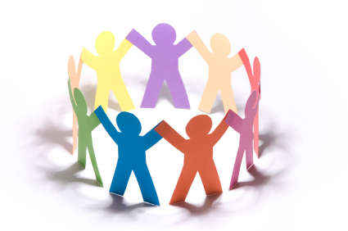
Stay Connected – Nurture Relationships Support System
Where our support system comes from:
Family
Friends
Coworkers
Roles they can play:
Confidant
Challenger
Fun
Chicken soup
Mentor
Spirituality
Drainer
Notes:
Slide 7:
Most of us could benefit from strengthening our connections with those who lift us up and support us. The people who make up our support system usually fall into one of these three categories: Family, Friends, or Co-worker. On the right-hand side are several roles people can fill in our lives. People in our lives can fill one or many of these roles. They are:
Confidant – A confidant is someone you can confide in, who you tell your most sensitive thoughts to.
Challenger– a challenger is someone who challenges you; who gets you to think “outside your comfort zone”. A challenger helps us learn and maintain our sense of curiosity and openness to learning. This is about a respectful discussion over a differences of opinions or views. It is not a shouting match.
Fun – think about who makes you laugh, gets you to let go and enjoy the moment.
Chicken soup – who takes care of you when you are not well?
Mentor – A mentor is someone who shows or has shown you the ropes in some endeavor in life and whose opinion you value.
Spirituality – this does not necessarily mean participating in formal religion, although it can; it can mean being understanding and acting on our connection to each other and the earth. It can mean being aware of something greater than ourselves and there are many ways that people can and do express this.
Drainer – A drainer is someone who takes your energy down.
These roles are filled by people in our families, our colleagues and co-workers and our friends. Think of the people who fulfill these roles in your life, then think about what you learned. Some of us are everyone else’s “chicken soup”, but we don’t have others who we can turn to when we need to be taken care of.
This is just for you; you don’t need to share it with anyone. It might point to areas where you could build on an existing relationship or form a new one.

Slide 8
Have a Sense of Purpose
Here are some questions to consider when thinking about your purpose:
What brings pleasure and meaning to your world? What do you love to do; what matters to you? What energizes you? What contribution do you want to make? What do others tell you they appreciate about you?
Notes:
Slide 8:
Having a purpose adds meaning to your life. Your purpose can be what you do professionally, it could be something you do in your personal life or a combination of both. Here are some questions to consider when thinking about your purpose: What brings pleasure and meaning to your world? Think about that, when are you most engaged? What do you love to do; what matters to you? Think of activities you do that are so enjoyable that the time just flies by or the causes that excite you and leave you feeling fulfilled when you engage in them. What energizes you? What contribution do you want to make? Is there some organization, or a group you want to be a part of? What do others tell you that they appreciate about you?

Slide 9
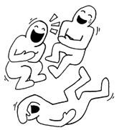
Keep laughing
Laughter,
the best medicine
Notes:
Slide 9:
Keep laughing! Laughter really is the best medicine! A sense of humor is a great help when you find yourself in a challenging time. There is great variety in what people find funny and our ability to find humor and have a good laugh even in the toughest times helps us stay resilient. Here are some of the benefits of laughter.

Slide 10
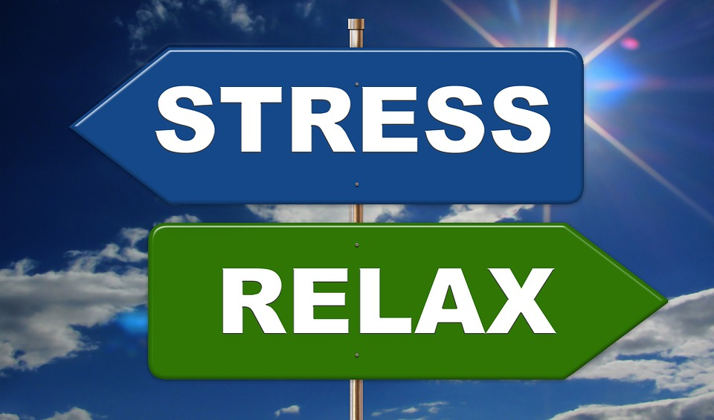
The Benefits of Laughter Short Term Effects
Stimulate many organs.
Activate and relieve your stress response.
Soothe tension.
Notes:
Slide 10:
Short-term benefits of laughter: A good laugh has great short-term effects. When you start to laugh, it doesn't just lighten your load mentally, it causes physical changes in your body. Laughter can:
Stimulate many organs. Laughter enhances your intake of oxygen-rich air, and that stimulates your heart, lungs and muscles, and increases the endorphins that are released by your brain.
It can activate and relieve your stress response. A hearty, good laugh fires up and then cools down your stress response, and it can increase and then decrease your heart rate and blood pressure. The result? A good, relaxed feeling. Think about the last time you had a good laugh and how relaxed you felt.
It can soothe tension. Laughter can also stimulate circulation and aid muscle relaxation, both of which can help reduce some of the physical symptoms of stress.
As a very funny person once said, “It’s impossible to lift furniture when you are laughing!”

Slide 11
The Benefits of Laughter Long Term Effects
Improves your immune system
Relieves pain
Increases personal satisfaction
Improves your mood
Notes:
Slide 11:
Long-term benefits:
Laughter isn't just a quick pick-me-up, though. It's also good for you over the long term. Laughter may:
Improve your immune system. Negative thoughts become chemical reactions that can affect your body by bringing more stress into your system and decreasing your immunity. By contrast, positive thoughts can release neuropeptides that help fight stress and potentially more-serious illnesses.
Relieves pain. Laughter may ease pain by causing the body to produce its own natural painkillers.
Increases personal satisfaction. Laughter can also make it easier to cope with difficult situations. It also helps you connect with other people. Think about a time when you shared a good laugh with someone, it may have helped you relate more readily to the other person.
Laughter can improve your mood, make you feel happier, and lessen feelings of anxiety.

Slide 12
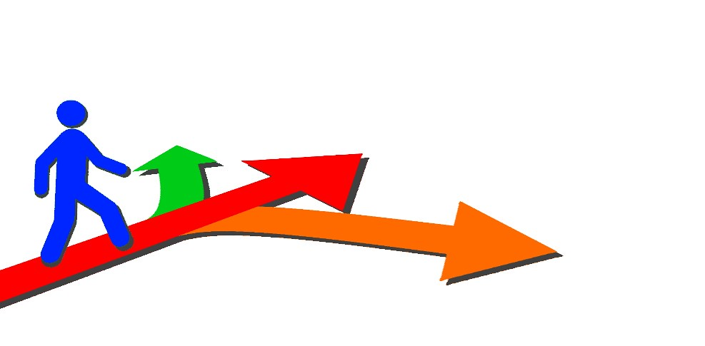
Choices in Life
You can choose:
What you focus on
What you think
What you say
What you do
Your attitude
How you respond to life
Your self talk
Notes:
Slide 12:
Here are some fundamental choices in life that each of us, for the most part, has control over. Think about how they can help you build your resilience and stay resilient:
You can choose:
What you focus on – Psychologists generally agree that our brains are hardwired to put more of our focus and energy on bad news. That can make it more difficult for us to remember that plenty of good, positive things are happening too. You don’t need to put your head in the sand and ignore what is going on around you, but you can choose how much information you want to take in at any one time. And you can choose to seek out the positive things happening in the world to give your information intake some balance.
What you think – our minds are some of the most fertile ground for stress.
What you say – how we speak to each other, the level of respect and courtesy we engage in can make a big difference when it comes to building a relationship and lowering stress
What you do – the actions you take to remain healthy, to remain engaged in life are all choices you get to make each day.
Your attitude – An attitude is a settled way of thinking or feeling about someone or something. Your attitude is within your sphere of control as is your view of yourself and others.
How you respond to life – everyone will face challenges in life; the choice is ours about how we deal with those challenges. Resilient people don't pretend everything is all right. They seize the initiative and do what they can to help themselves and others. Resilient people reframe the event. They make a mental shift that allows them to see themselves not as a victim but as a survivor.
Here is just one example of how someone we view as successful today dealt with the inevitable failures and challenges of life. There are many more. In fact, most people who are successful in life, have gotten there because they overcame obstacles.
As a high school sophomore, Michael Jordan was cut from the varsity basketball team. Instead of being discouraged, he motivated himself to put in extra practice time and made the team the next year. Learning this lesson of dedication early allowed Jordan to succeed later in both college and professional basketball, no matter what obstacles came his way. "I've missed more than 9,000 shots in my career. I've lost almost 300 games. Twenty-six times, I've been trusted to take the game winning shot and missed.” "I've failed over and over and over again in my life. And that is why I succeed."
Your self-talk - Engaging in habitual self-defeating talk is like having a false friend who puts you down all day long. You probably wouldn’t want to hang out with that person for very long. So, find ways to be a good friend to yourself. Focus on the things you do well, on the compliments you receive, these are as true a statement about you as any other. Build on your successes.

Slide 13
Summing It Up Building Resiliency
Determine what you have control over
Develop supportive relationships
Live well:
Proper nutrition
Regular exercise
Adequate rest
Humor, play & creativity
Practice relaxation techniques
Notes:
Slide 13:
Summing up: Determine what you have control over
Develop supportive relationships – look for people who nurture you and who value you. Good friends are both honest with us and caring toward us.
Live well:
Proper nutrition
Regular exercise – you don’t have to run a marathon – just move 30 minutes a day doing something you enjoy.
Adequate rest – again, rest is not just restorative to the body, it is vital for restoring our minds.
Humor, play & creativity – nurture your sense of humor and your creative side. Not everyone paints, draws, or plays music, but if you garden you paint with flowers, make music by giving humming birds and bees a place to come. And some people find their creativity by interacting with others to bring joy to their lives. You are most likely far more creative than you know!
Practice relaxation techniques – deep breathing, meditation, connecting with nature – the list is endless

Slide 14
Don’t Forget, Living Resources Has Many Services For You
Contact information: www.Maine.Gov/bhr/oeh
Benefits
Services: Confidential, short-term counseling services Legal and financial information, support and resources
Work-life solutions
Please contact me at:
Kathleen.d.carnes@maine.gov
Telephone: 623-6730
Notes:
Slide 14:
And don’t forget, Living Resources has many services for you
You can find this information on the website for the Office of Employee Health and Benefits. You will find the information on Living Resources under the Benefits tab.
During these very trying and challenging times you will also find many resources under the Covid-19 tab on this website. The services offered by Living Resources are:
Confidential, short-term counseling services This no-cost counseling service can help with issues such as stress, anxiety, depression, grief, etc.
Legal and financial information, support and resources: You can speak with professionals by phone on a wide range of issues including family law, real estate transactions, debt consolidation, taxes, etc.
Work-life solutions Work-life specialists are available to do research and provide qualified referrals for child and elder care, moving and relocation, college planning and much more!
So, thank you for taking the time to view this program. Please feel free to contact me by email or phone. Your feedback helps improve programs and is appreciated.
Most of all stay well and stay safe!

